Slide 1
”AI Based COVID -19 PREDICTIONS”
By :
Under the guidance of :

Slide 2
CONTENTS OF THIS PROJECT
MISSION STATEMENT: Develop a covid vaccine support program to help health institutes in analysing data, and provide a system for tracking vaccinated patients using blockchain technology.
COVID
EXPLORER
COVID BUDDY
BLOCKVAX
CONTRACT
Using Streamlit and Altair for dashboard Functionality,
Machine Learning Algorithms to analyse trends among different countries &
Python for other advanced data analysis.
Chat-bot to communicate and answer questions with the Public about covid related queries.
Using Solidity to create a patient contract to verify whether patient has been vaccinated or not.
DATA SOURCE: https://github.com/owid/covid-19-data
We implemented a function to download the latest data from the website.

Slide 3
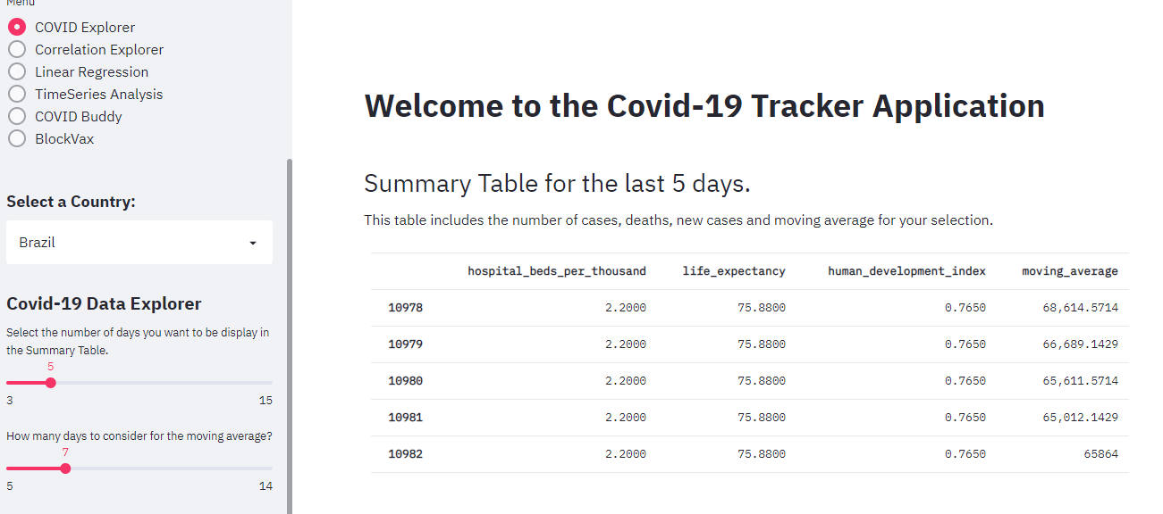
COVID DATA EXPLORER

Slide 4
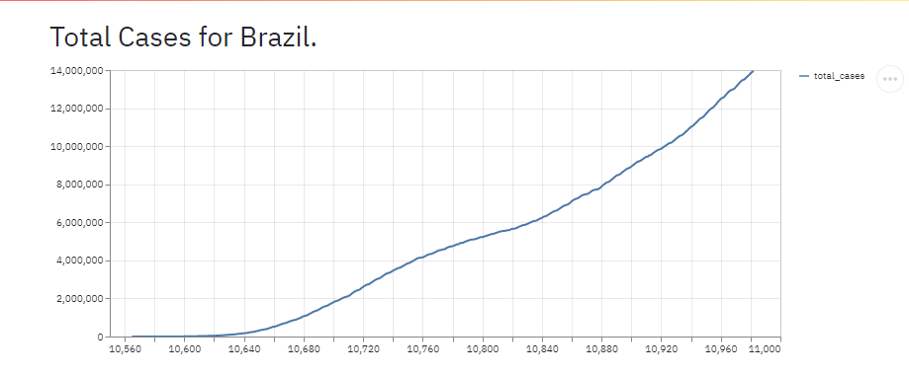
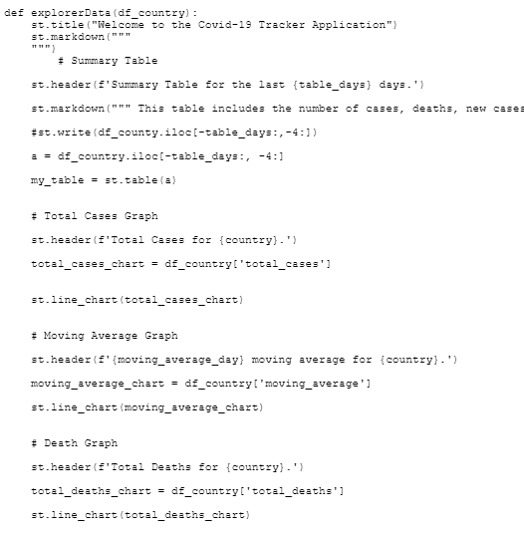
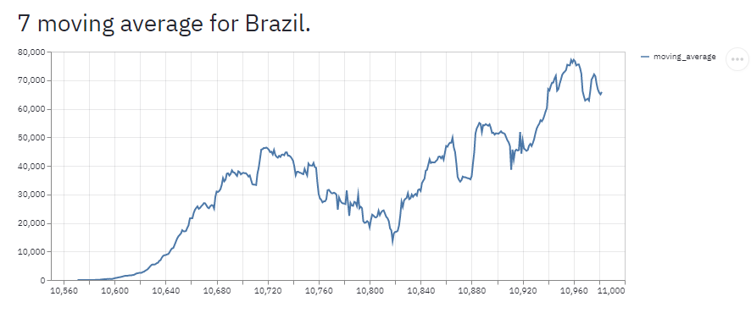
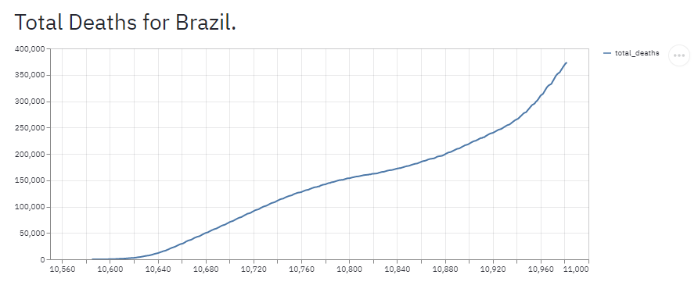
COVID EXPLORER GRAPHS

Slide 5
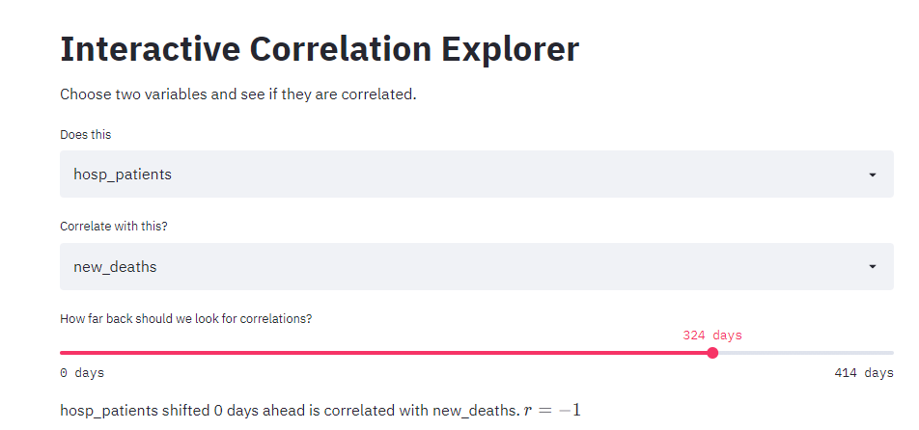
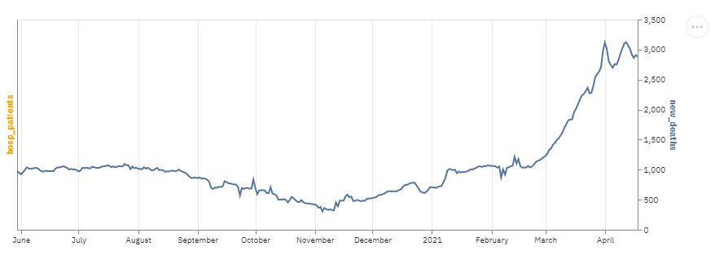
COVID EXPLORER - CORRELATIONS
This function was developed to check whether variables are correlated.
Out of 56 variables in our data set only 7 variables are used to compare correlation data.
Based on the total data available in the csv file, the program is calculates how many days worth of data is available.
Using the Slider, we choose the number of days we want to plot the correlation between two variables for.

Slide 6
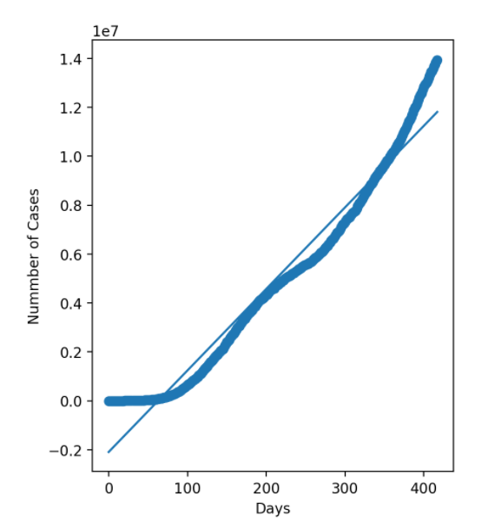
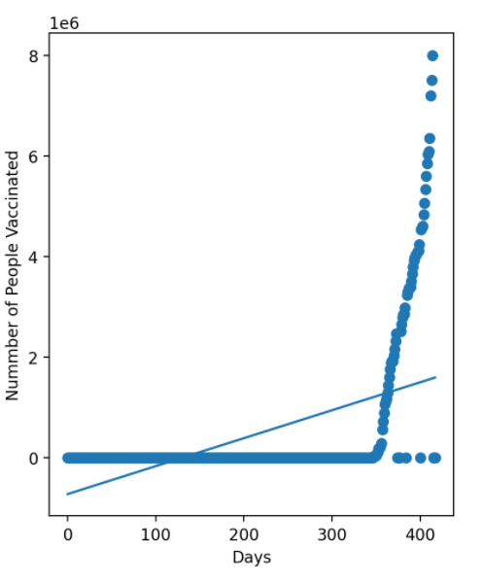
COVID EXPLORER – LINEAR REGRESSIONS
PREDICTED TREND OF BRAZIL COVID CASES USING LINEAR REGRESSION
PREDICTED TREND OF BRAZIL VACCINATIONS USING LINEAR REGRESSION

Slide 7
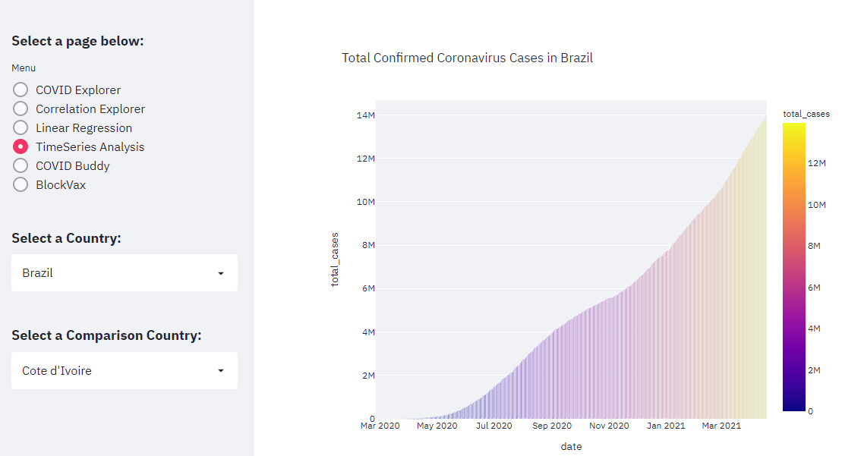
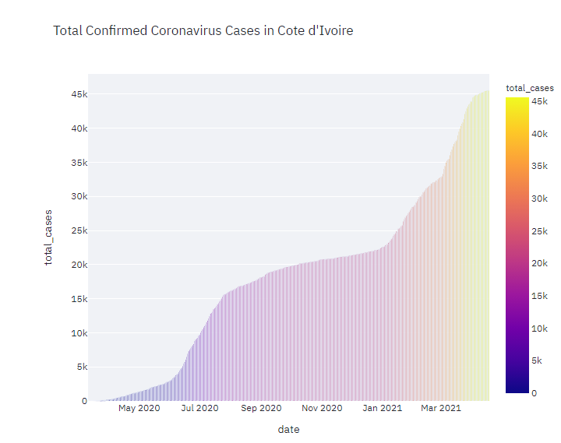
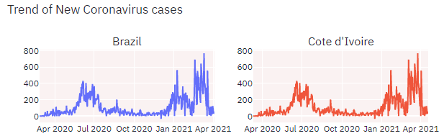
COVID EXPLORER – TIME SERIES

Slide 8
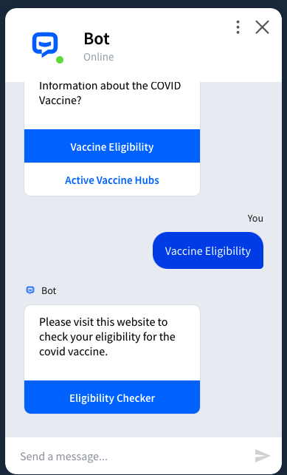
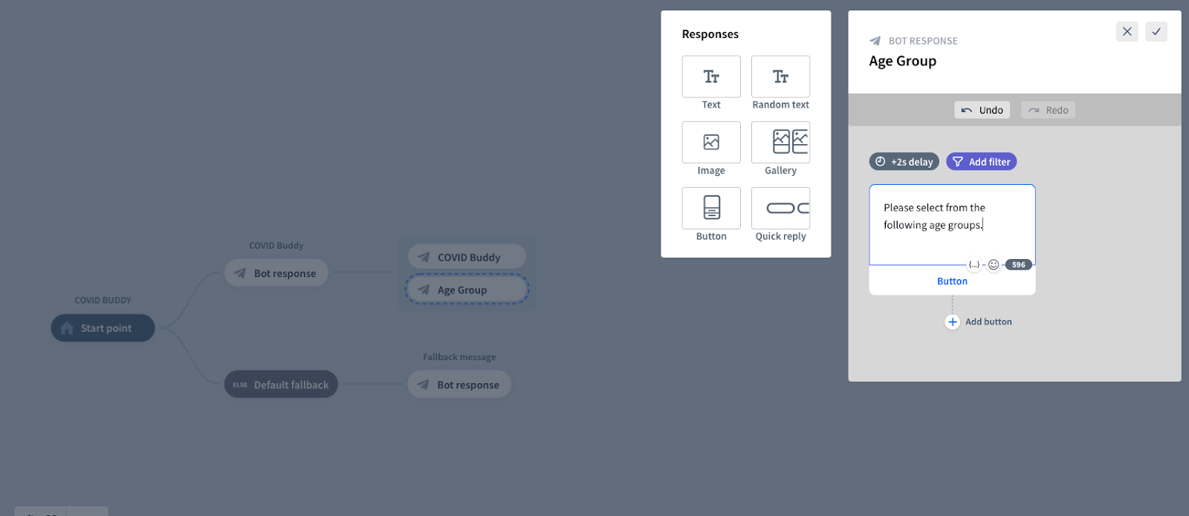
COVID BUDDY – INTERACTIVE CHATBOT
CHAT BOT FUNCTIONALITY

Slide 9


BLOCK VAX
Smart Contract - 3 Functions
User Registration
Address
Patient ID Number
Photo ID (URI)
Vaccine Data Update
Registered Provider
Vaccine Name
Mint ERC721 Token (VAX)
Set Token URI
Vaccinated Profile Check
x

Slide 10
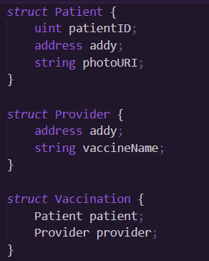
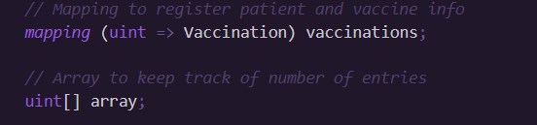
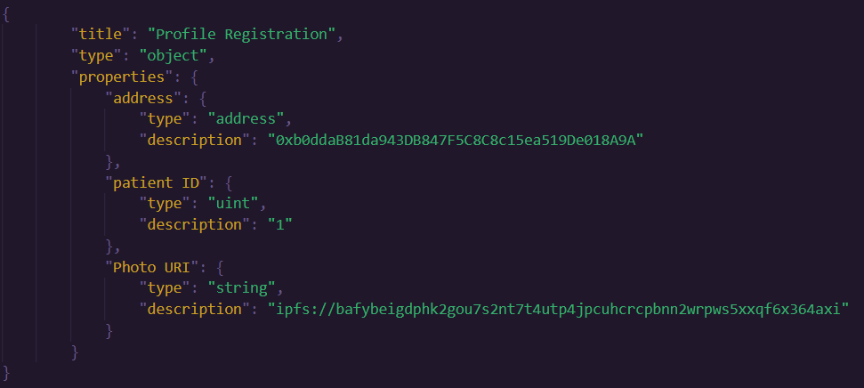
BLOCK VAX PROFILE & VACCINE REGISTRATION

Slide 11
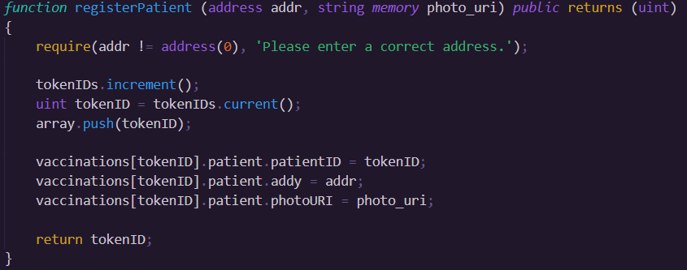
BLOCK VAX PATIENT REGISTRATION

Slide 12
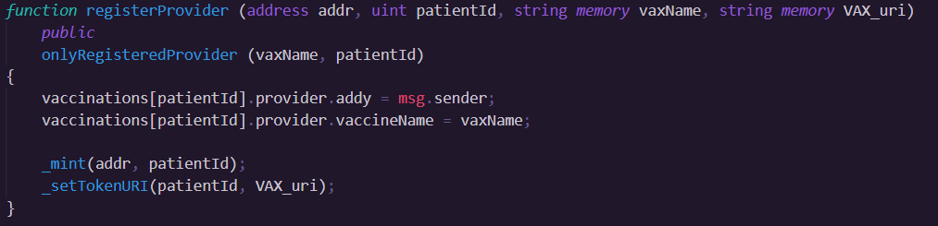
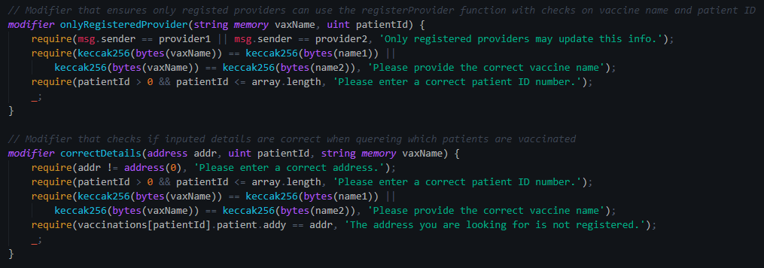
BLOCK VAX REGISTER PROVIDERS & VALIDATE

Slide 13
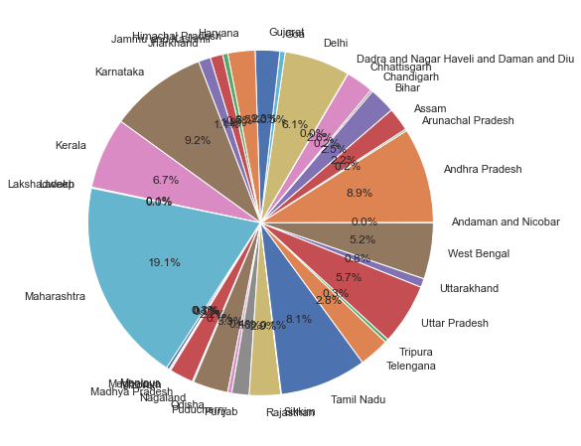
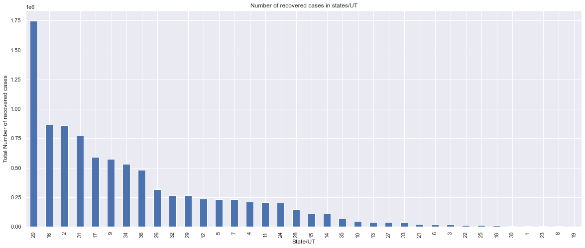
EXPERIMENTAL RESULTS
Fig.1 Illustrating total confirmed cases
Fig.2 Illustrating recovered cases in particular state

Slide 14
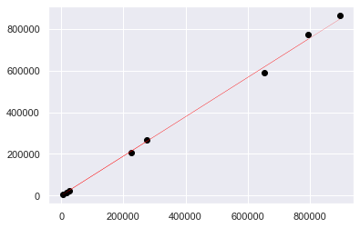
CONCLUSION
This is the final result of linear regression technique applied on the dataset. Here, line represents the predicted value and black circle represents the actual value.
As the figure shows, there is not much difference between actual and predicted value.
As this graph is between confirmed cases and recovered cases, we are able to analyse that recovery rate is nearly similar in all the states or U.T.

Slide 15
References
1.https://discuss.streamlit.io/ 2. https://streamlit.io/gallery?type=apps&category=geography-society 3. https://www.youtube.com/watch?v=k-d27B5hnqc 4. https://github.com/E-Health/vac-chain/blob/develop/contracts/Encounter.sol 5. https://app.chatbot.com/dashboard/608903c2be6c8d0007f958a1

Slide 16
Questions ?

Slide 17
Thank You…

